Slide 1
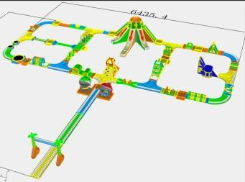
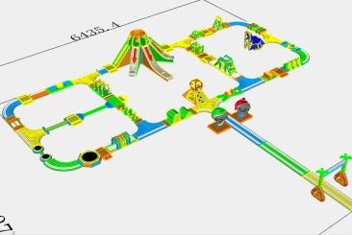
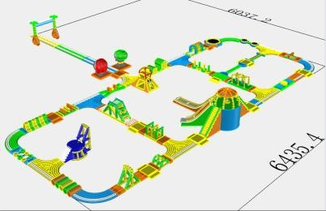
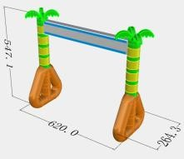
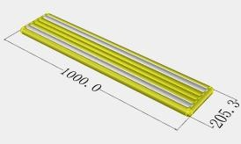
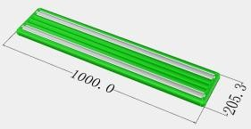
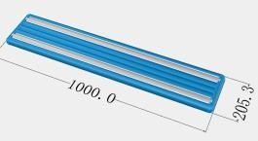
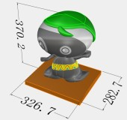
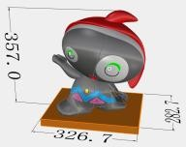
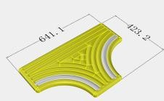
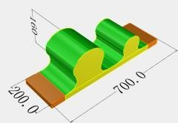
머드워터파크 플롯팅구조물 재단보유내역
Name | Image | Size | QTY | Description
1 |  | 6.2x2.64x5.47m | 1 | 0.9mm MATE PVC Tarpaulin (28x26mm) 840D liner + 0.9mm reinfore webbing inside Good quality inflating valve + deflating valve With silk printing logo + safety warning
2 |  | 10x2.05m | 1 | 0.9mm MATE PVC Tarpaulin (28x26mm) 840D liner + 0.9mm reinfore webbing inside Good quality inflating valve + deflating valve With silk printing logo + safety warning
3 |  | 10x2.05m | 1 | 0.9mm MATE PVC Tarpaulin (28x26mm) 840D liner + 0.9mm reinfore webbing inside Good quality inflating valve + deflating valve With silk printing logo + safety warning
4 |  | 10x2.05m | 1 | 0.9mm MATE PVC Tarpaulin (28x26mm) 840D liner + 0.9mm reinfore webbing inside Good quality inflating valve + deflating valve With silk printing logo + safety warning
5 |  | 3.267x3.57x2.827m | 1 | 0.9mm MATE PVC Tarpaulin (28x26mm) 840D liner + 0.9mm reinfore webbing inside Good quality inflating valve + deflating valve With silk printing logo + safety warning
6 |  | 3.267x3.57x2.827m | 1 | 0.9mm MATE PVC Tarpaulin (28x26mm) 840D liner + 0.9mm reinfore webbing inside Good quality inflating valve + deflating valve With silk printing logo + safety warning
7 |  | 6.411x4.232m | 1 | 0.9mm MATE PVC Tarpaulin (28x26mm) 840D liner + 0.9mm reinfore webbing inside Good quality inflating valve + deflating valve With silk printing logo + safety warning
8 |  | 7x2x1.6m | 1 | 0.9mm MATE PVC Tarpaulin (28x26mm) 840D liner + 0.9mm reinfore webbing inside Good quality inflating valve + deflating valve With silk printing logo + safety warning

Slide 2
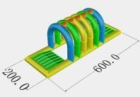
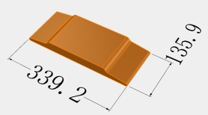
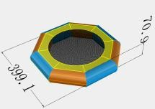
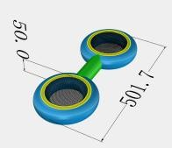
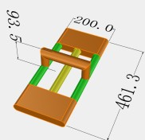
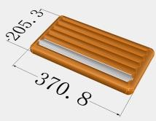
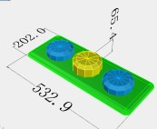
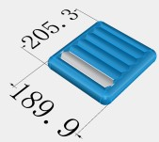
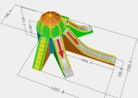
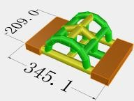
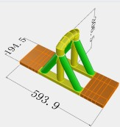
9 |  | 6x2m | 1 | 0.9mm MATE PVC Tarpaulin (28x26mm) 840D liner + 0.9mm reinfore webbing inside Good quality inflating valve + deflating valve With silk printing logo + safety warning
10 |  | 3.4x1.36m | 1 | 0.9mm MATE PVC Tarpaulin (28x26mm) 840D liner + 0.9mm reinfore webbing inside Good quality inflating valve + deflating valve With silk printing logo + safety warning
11 |  | 3.99x0.7m | 1 | 0.9mm MATE PVC Tarpaulin (28x26mm) 840D liner + 0.9mm reinfore webbing inside Good quality inflating valve + deflating valve With silk printing logo + safety warning
12 |  | 5x0.5m | 1 | 0.9mm MATE PVC Tarpaulin (28x26mm) 840D liner + 0.9mm reinfore webbing inside Good quality inflating valve + deflating valve With silk printing logo + safety warning
13 |  | 4.61x2x0.935m | 1 | 0.9mm MATE PVC Tarpaulin (28x26mm) 840D liner + 0.9mm reinfore webbing inside Good quality inflating valve + deflating valve With silk printing logo + safety warning
14 |  | 3.7x2.053m | 1 | 0.9mm MATE PVC Tarpaulin (28x26mm) 840D liner + 0.9mm reinfore webbing inside Good quality inflating valve + deflating valve With silk printing logo + safety warning
15 |  | 5.32x2.02x0.654m | 1 | 0.9mm MATE PVC Tarpaulin (28x26mm) 840D liner + 0.9mm reinfore webbing inside Good quality inflating valve + deflating valve With silk printing logo + safety warning
16 |  | 2.05x1.89m | 1 | 0.9mm MATE PVC Tarpaulin (28x26mm) 840D liner + 0.9mm reinfore webbing inside Good quality inflating valve + deflating valve With silk printing logo + safety warning
17 |  | 14.378x12.825m | 1 | 0.9mm MATE PVC Tarpaulin (28x26mm) 840D liner + 0.9mm reinfore webbing inside Good quality inflating valve + deflating valve With silk printing logo + safety warning
18 |  | 3.45x2.09m | 1 | 0.9mm MATE PVC Tarpaulin (28x26mm) 840D liner + 0.9mm reinfore webbing inside Good quality inflating valve + deflating valve With silk printing logo + safety warning
19 |  | 6x1.94x3.06m | 1 | 0.9mm MATE PVC Tarpaulin (28x26mm) 840D liner + 0.9mm reinfore webbing inside Good quality inflating valve + deflating valve With silk printing logo + safety warning

Slide 3
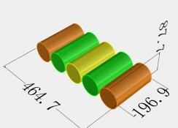
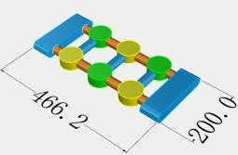
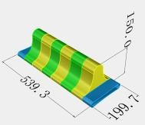
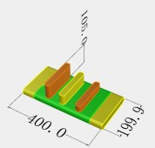
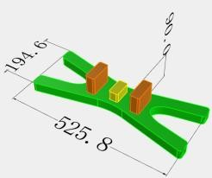
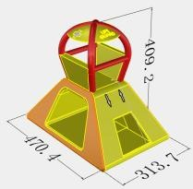
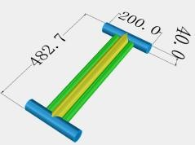
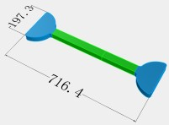
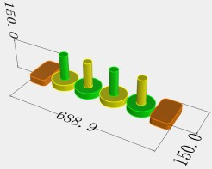
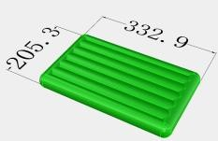
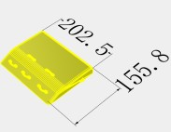
20 |  | 4.647x1.969x0.877 m | 1 | 0.9mm MATE PVC Tarpaulin (28x26mm) 840D liner + 0.9mm reinfore webbing inside Good quality inflating valve + deflating valve With silk printing logo + safety warning
21 |  | 4.662x2x0.3m | 1 | 0.9mm MATE PVC Tarpaulin (28x26mm) 840D liner + 0.9mm reinfore webbing inside Good quality inflating valve + deflating valve With silk printing logo + safety warning
22 |  | 5.393x1.997x1.5m | 1 | 0.9mm MATE PVC Tarpaulin (28x26mm) 840D liner + 0.9mm reinfore webbing inside Good quality inflating valve + deflating valve With silk printing logo + safety warning
23 |  | 4x2x1.05m | 1 | 0.9mm MATE PVC Tarpaulin (28x26mm) 840D liner + 0.9mm reinfore webbing inside Good quality inflating valve + deflating valve With silk printing logo + safety warning
24 |  | 5.258x1.946x0.9m | 1 | 0.9mm MATE PVC Tarpaulin (28x26mm) 840D liner + 0.9mm reinfore webbing inside Good quality inflating valve + deflating valve With silk printing logo + safety warning
25 |  | 4.7x3.137x4.092m | 1 | 0.9mm MATE PVC Tarpaulin (28x26mm) 840D liner + 0.9mm reinfore webbing inside Good quality inflating valve + deflating valve With silk printing logo + safety warning
26 |  | 4.827x2x0.4m | 1 | 0.9mm MATE PVC Tarpaulin (28x26mm) 840D liner + 0.9mm reinfore webbing inside Good quality inflating valve + deflating valve With silk printing logo + safety warning
27 |  | 7.164x1.973m | 1 | 0.9mm MATE PVC Tarpaulin (28x26mm) 840D liner + 0.9mm reinfore webbing inside Good quality inflating valve + deflating valve With silk printing logo + safety warning
28 |  | 6.889x1.5x1.5m | 1 | 0.9mm MATE PVC Tarpaulin (28x26mm) 840D liner + 0.9mm reinfore webbing inside Good quality inflating valve + deflating valve With silk printing logo + safety warning
29 |  | 3.329x2.053m | 1 | 0.9mm MATE PVC Tarpaulin (28x26mm) 840D liner + 0.9mm reinfore webbing inside Good quality inflating valve + deflating valve With silk printing logo + safety warning
30 |  | 2.025x1.558m | 1 | 0.9mm MATE PVC Tarpaulin (28x26mm) 840D liner + 0.9mm reinfore webbing inside Good quality inflating valve + deflating valve With silk printing logo + safety warning

Slide 4
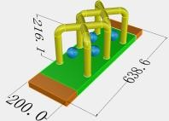
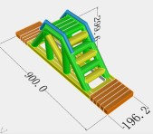
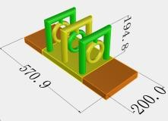
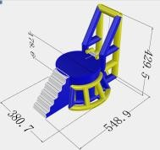
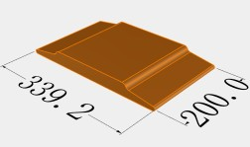
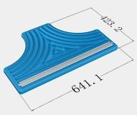
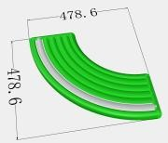
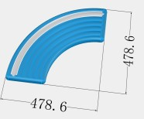
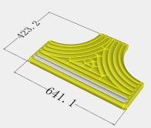
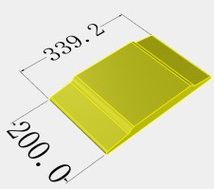
31 |  | 3.686x2x2.161m | 1 | 0.9mm MATE PVC Tarpaulin (28x26mm) 840D liner + 0.9mm reinfore webbing inside Good quality inflating valve + deflating valve With silk printing logo + safety warning
32 |  | 9x2x3m | 1 | 0.9mm MATE PVC Tarpaulin (28x26mm) 840D liner + 0.9mm reinfore webbing inside Good quality inflating valve + deflating valve With silk printing logo + safety warning
33 |  | 5.7x2x1.94m | 1 | 0.9mm MATE PVC Tarpaulin (28x26mm) 840D liner + 0.9mm reinfore webbing inside Good quality inflating valve + deflating valve With silk printing logo + safety warning
34 |  | 5.48x3.8x1.786m | 1 | 0.9mm MATE PVC Tarpaulin (28x26mm) 840D liner + 0.9mm reinfore webbing inside Good quality inflating valve + deflating valve With silk printing logo + safety warning
35 |  | 4x2x0.3m | 2 | 0.9mm MATE PVC Tarpaulin (28x26mm) 840D liner + 0.9mm reinfore webbing inside Good quality inflating valve + deflating valve With silk printing logo + safety warning
36 |  | 6.41x4.232m | 2 | 0.9mm MATE PVC Tarpaulin (28x26mm) 840D liner + 0.9mm reinfore webbing inside Good quality inflating valve + deflating valve With silk printing logo + safety warning
37 |  | 4.786x4.786m | 2 | 0.9mm MATE PVC Tarpaulin (28x26mm) 840D liner + 0.9mm reinfore webbing inside Good quality inflating valve + deflating valve With silk printing logo + safety warning
38 |  | 4.786x4.786m | 2 | 0.9mm MATE PVC Tarpaulin (28x26mm) 840D liner + 0.9mm reinfore webbing inside Good quality inflating valve + deflating valve With silk printing logo + safety warning
39 |  | 6.411x4.232m | 4 | 0.9mm MATE PVC Tarpaulin (28x26mm) 840D liner + 0.9mm reinfore webbing inside Good quality inflating valve + deflating valve With silk printing logo + safety warning
40 |  | 3.4x2x0.3m | 6 | 0.9mm MATE PVC Tarpaulin (28x26mm) 840D liner + 0.9mm reinfore webbing inside Good quality inflating valve + deflating valve With silk printing logo + safety warning
- 상기리스트 중 17번, 25번, 34번 등 어린이가 체험하기 위험한 구조물은 제외하고 선택
- 이음용(부교형)과 체험용 구조물을 적절히 연결하여 구성안 제시

